Slide 1
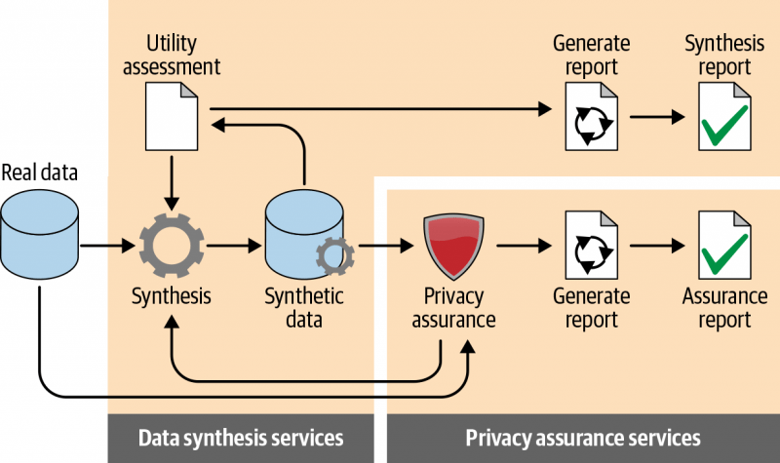
SYNTHETIC DATA GENERATION
Synthetic data generation is a technique to produce the data artificially.
It is used for the purpose of preserving privacy , testing systems or creating training data for machine learning algorithm.
How do businesses generate synthetic data?

Slide 2
PYTHON LIBRARIES TO SYNTHESIZE THE DATA
There are many libraries in python available for to generate synthetic data by writing its code in python script.
Faker
Trumania
Pydbgen
Sumpy
Synthetic Data Vault (SDV)

Slide 3
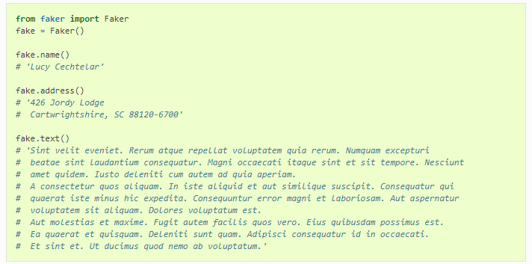
Faker library for synthetic data
Faker is very famous python library for synthetic data generation but we can not input our csv file for data generation. Faker has its own code format so we can generate only limited type of data.

Slide 4
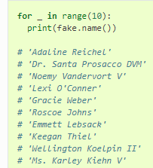
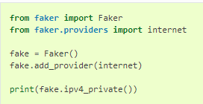
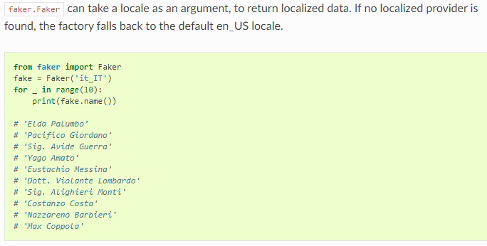

Slide 5
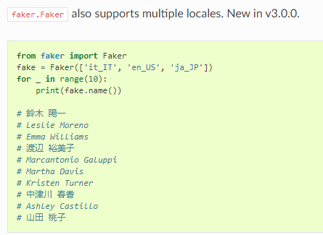
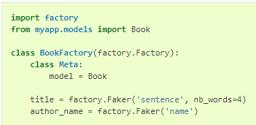
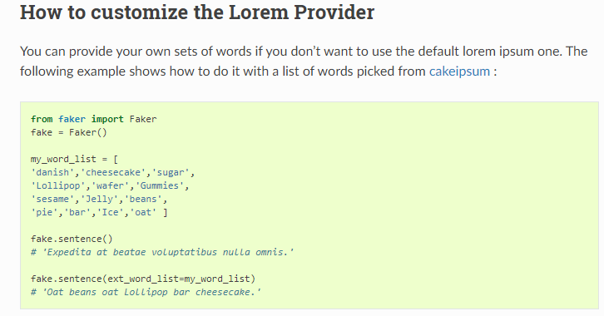

Slide 6


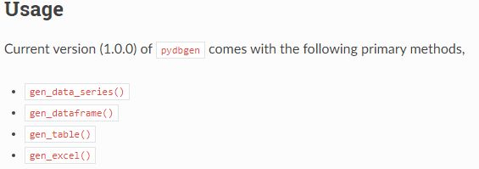
Pydbgen
This python package generate random database based on users choice of database. At its core, pydbgen uses Faker as the default random data generating engine for most of the data types. The original contribution of pydbgen is to take the single data-generating function from Faker and use it cleverly to generate Pandas data series or dataframe or SQLite database tables as per the specification of the user.

Slide 7
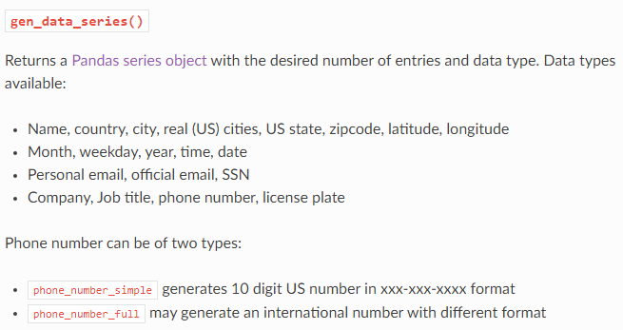
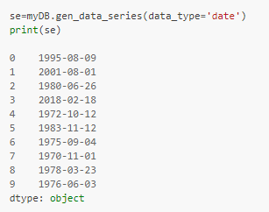
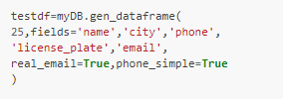


Slide 8
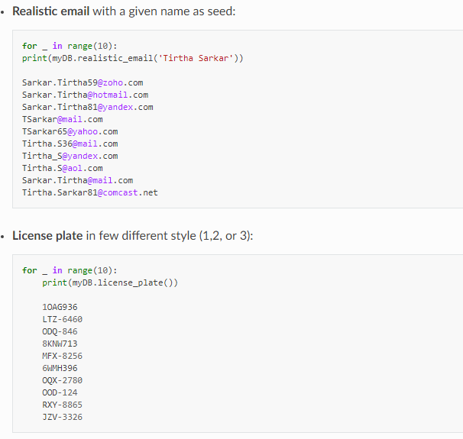

Slide 9
LIMITAION-
We have found some limitation while using above packages
We can not input our csv data to get synthetic data as output
We can generate single individual feature at a time and with limited variation eg. Complex Bank Account number etc.
We can not set hyper parameter to preserve the same statistical feature in generated data eg. Skewness
4. It is too difficult to maintain the correlation among the features of the synthetic data which original data has.

Slide 10
GRETEL LIBRARY FOR SYNTHETIC DATA GENERATION
We have got the gretel as the most flexible libraray for synthetic data generation from input csv data file.
In gretel there are two ways of generating the synthetic data
1- Use the code of gretel library in python
2- Use the application of gretel available on their official website
We have use the second option and got the report of synthesised data

Slide 11
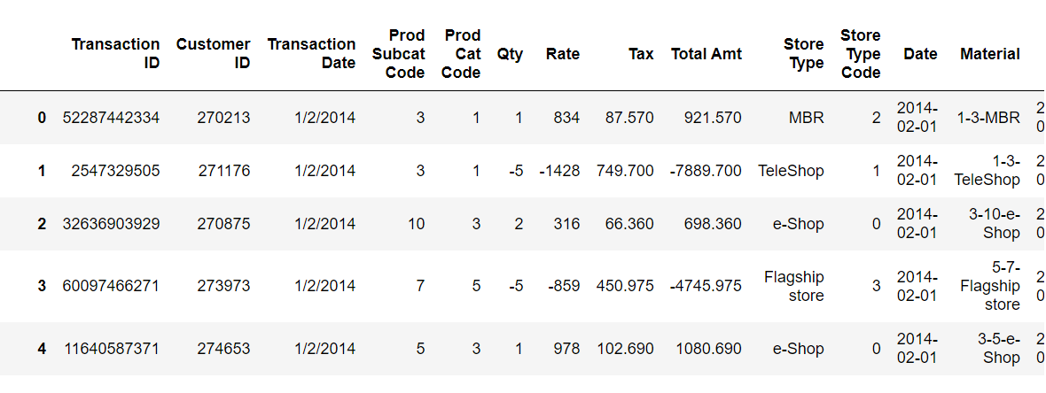
INPUT DATA
We have taken an e- commerce csv data as sample for input

Slide 12
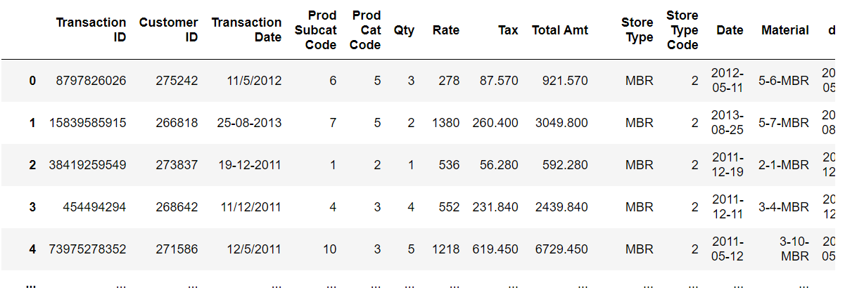
SYNTHESISED OUTPUT DATA

Slide 13
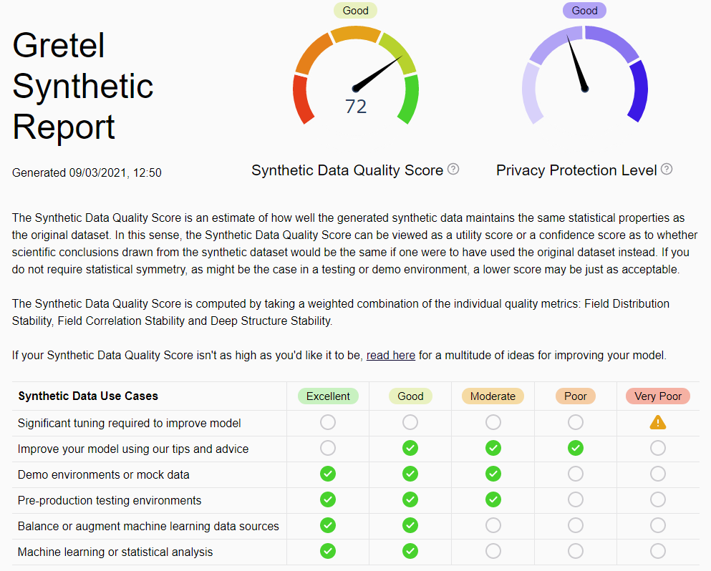
REPORT OF SYNTHESISED DATA

Slide 14
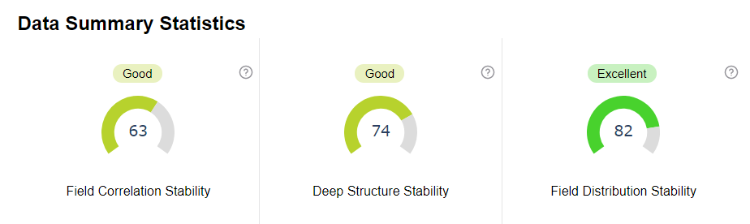
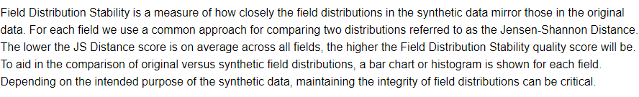
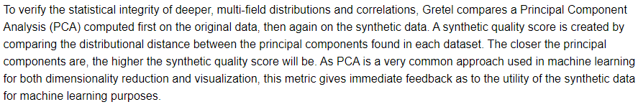
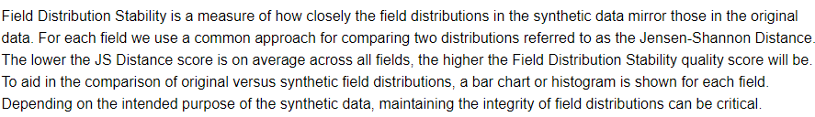

Slide 15
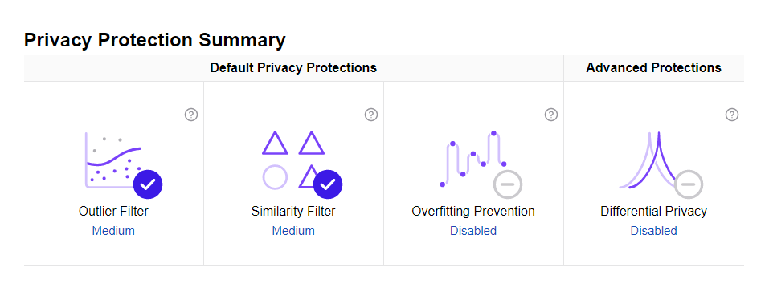
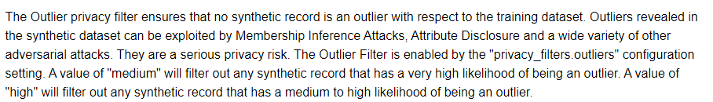
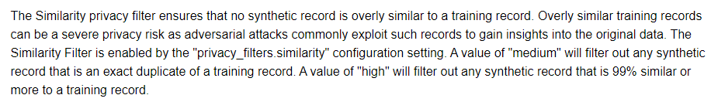


Slide 16
Privacy Protection Summary
Differential Privacy ensures that no individual training record can unduly influence the output of a synthetic model. It is very effective at preventing the generation of records that are overly similar to the training set and at ensuring an even distribution of values, though it can result in a modest degradation of the SQS utility score. Differential privacy is best suited to larger datasets (typically 50K rows or more) where probabilistic privacy guarantees are required.

Slide 17
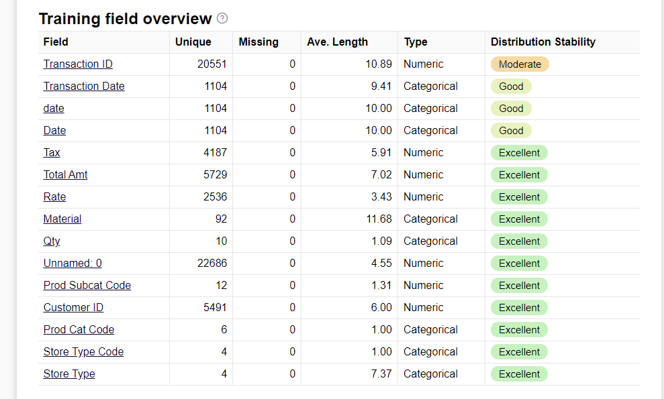

Slide 18
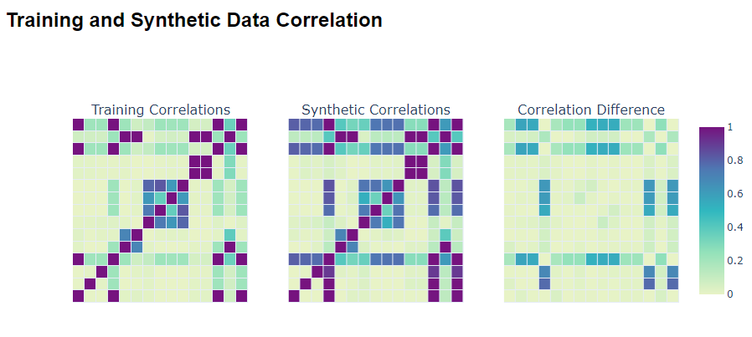
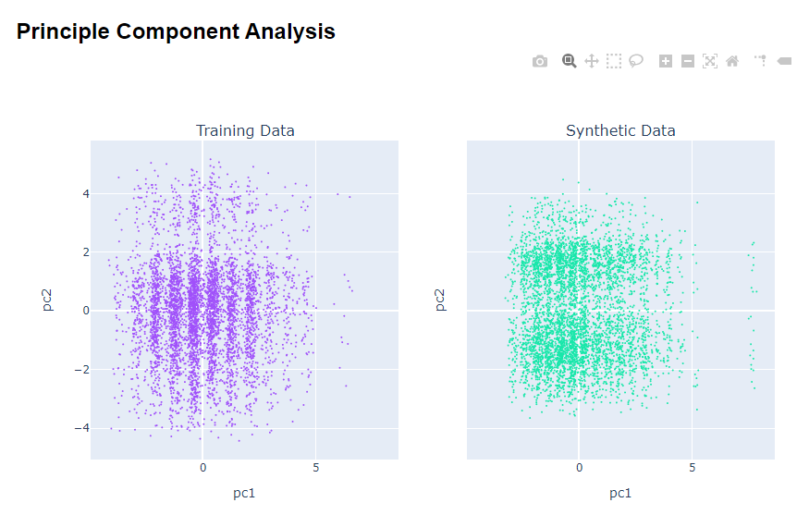
Now see the comparison b/w actual and synthesised data

Slide 19
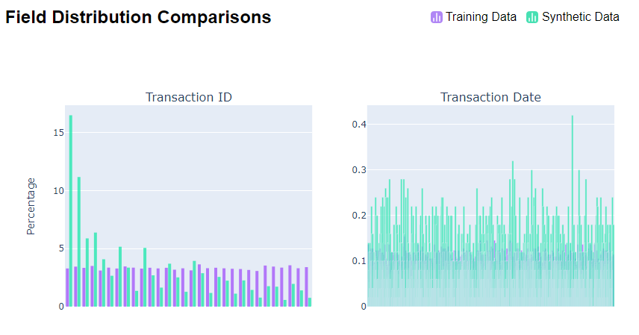
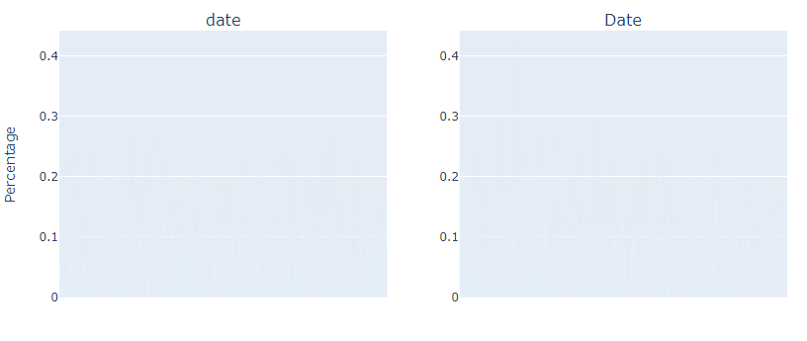

Slide 20
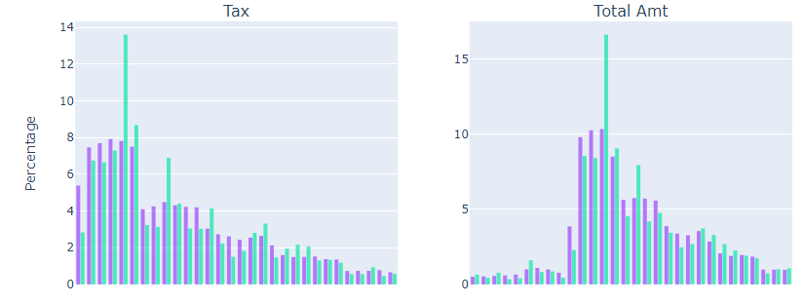
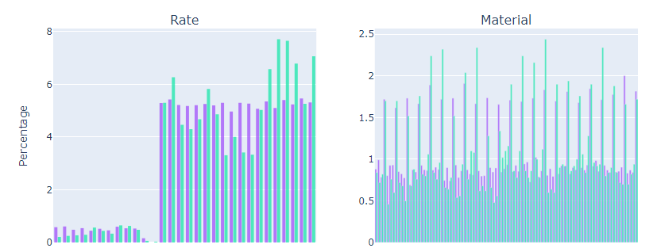

Slide 21
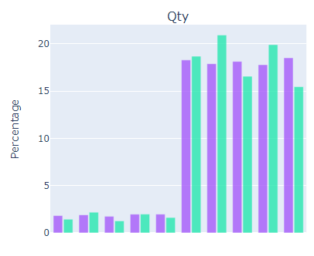
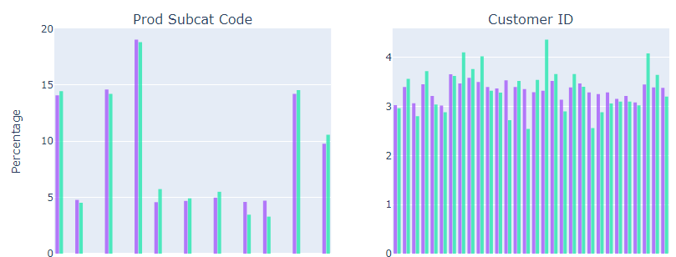

Slide 22
